Slide 1
Time Series Classification for Human Activity Recognition with LSTMs using TensorFlow 2 and Keras
Afsana Rahman Mou

Slide 2
HUMAN ACTIVITY RECOGNITION
Human activity recognition, or HAR, is a challenging time series classification task.
Human activity recognition(HAR ) is a broad field of study concerned with identifying the specific movement or action of a person based on sensor data.
It involves predicting the movement of a person based on sensor data and traditionally involves deep domain expertise and methods from signal processing to correctly engineer features from the raw data in order to fit a machine learning model.
Recently, deep learning methods such as convolutional neural networks and recurrent neural networks have shown capable and even achieve state-of-the-art results by automatically learning features from the raw sensor data.

Slide 3
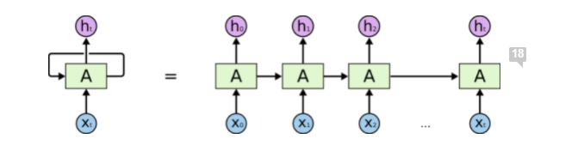
Recurrent Neural Network Models
Recurrent neural networks (RNNs) are a type of neural network that was designed to learn from sequence data, such as sequences of observations over time, or a sequence of words in a sentence.
A recurrent neural network can be thought of as multiple copies of the same network, each passing a message to a successor.
If we are using the activation functions, then it becomes very tedious to process long sequences.
It faces issues like Exploding or Gradient Vanishing.

Slide 4
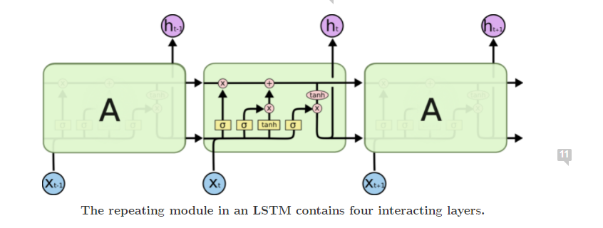
Long Short-Term Memory Network (LSTM)
Long Short Term Memory networks are a special kind of RNN, capable of learning long-term dependencies.
A layer in an LSTM model is comprised of special units that have gates that govern input, output, and recurrent connections, the weights of which are learned.
Each LSTM unit also has internal memory or state that is accumulated as an input sequence is read and can be used by the network as a type of local variable or memory register.
The LSTM is trained in a way that pays specific attention to observations made and prediction errors made over the time steps in the input sequence, called backpropagation through time.

Slide 5
TensorFlow 2.0 and Keras
TensorFlow 2 is an end-to-end, open-source machine learning platform.
TensorFlow 2.0 focuses on simplicity and ease of use, with updates like eager execution, intuitive higher-level APIs, and flexible model building on any platform.
Keras is the high-level API of TensorFlow 2.
An approachable, highly-productive interface for solving machine learning problems, with a focus on modern deep learning. It provides essential abstractions and building blocks for developing and shipping machine learning solutions with high iteration velocity.

Slide 6
Dataset
Data is collected through controlled laboratory conditions. It is provided by the WISDM: WIreless Sensor Data Mining lab.
Statistics
Raw Time Series Data
Number of examples: 1,098,207
Number of attributes: 6
Missing attribute values: None
Class Distribution
Walking: 424,400 (38.6%)
Jogging: 342,177 (31.2%)
Upstairs: 122,869 (11.2%)
Downstairs: 100,427 (9.1%)
Sitting: 59,939 (5.5%)
Standing: 48,395 (4.4%)

Slide 7
References
https://arxiv.org/abs/1707.03502
https://ieeexplore.ieee.org/document/7026300
https://www.mdpi.com/1424-8220/17/11/2556
https://www.youtube.com/watch?v=XOEN9W05_4A&ab_channel=JorgeLuisReyesOrtiz

Slide 8
THANK YOU

